Slide 1
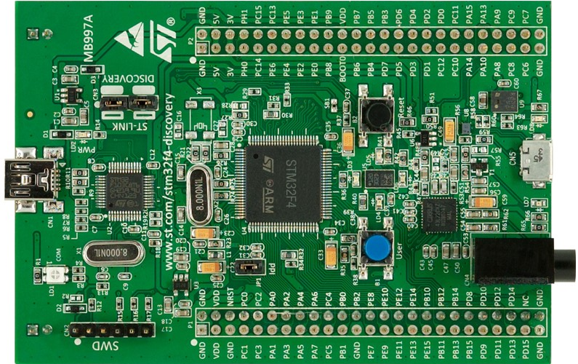
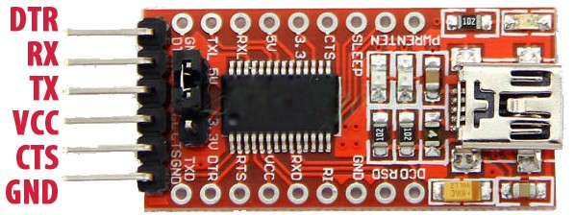
STM32 RX6 (PC7)
STM32 TX6 (PC6)
USB FOR SERIAL MONITOR
USB FOR ST LINK
ST LINK

